Slide 1
Plotting & Publishing
We will talk about publishing on Friday
Instead I will walk you through a test quiz

Slide 2
What we are going to learn
Plotting 2D graphics
Plot, line attributes, other properties
Formatting: Labels, titles, legends, …
Multiple plots (overlaid, sub-plots)
Other plot commands
Publishing scripts to documents
HTML
Microsoft Word
PDF

Slide 3
But first, let’s talk about the colon operator!

Slide 4
Colon Operator Create an array (vector or Matrix)
doc colon
Syntax:
x = <begin>:<end>
y = <begin>:<StepSize>:<end>
Examples:
>> x = 1:5
x = 1 2 3 4 5
>> y = 10:-2:0
y = 10 8 6 4 2 0
>> z = 5:3:12
z = 5 8 11

Slide 5
Do these on the computer! (and them put in script)
>> x = 2:8
x =
2 3 4 5 6 7 8
>> x = 2: 2: 8
x =
2 4 6 8
>> y = 8: -2 : 2
y =
8 6 4 2
>> y - x
ans =
6 2 -2 -6
>> x + y./2
ans =
6 7 8 9

Slide 6
size, length functions
doc size
doc length
size: returns size of each dimension in an array
x = 1, size(x) ans = 1 1
y = 1:5, size( y ) ans = 1 5
size( y' ) ans = 5 1
Z = [1 2 3; 4 5 6]
size(z) ans = 2 3
length: returns size of largest dimension
length(z) ans = 3

Slide 7
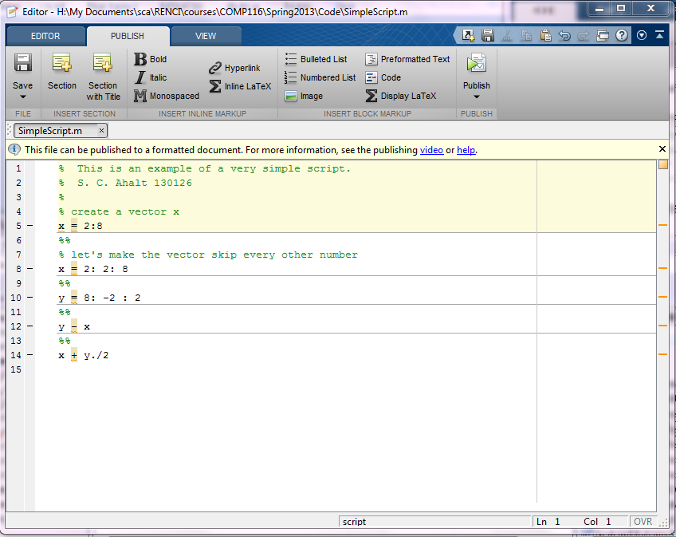
Short example of scripts and publishing….

Slide 8
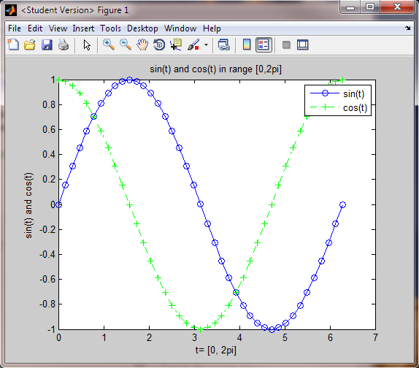
2D Plotting Basics x vs. y t vs. sin(t) or cos(t)
Figure
Window

Slide 9
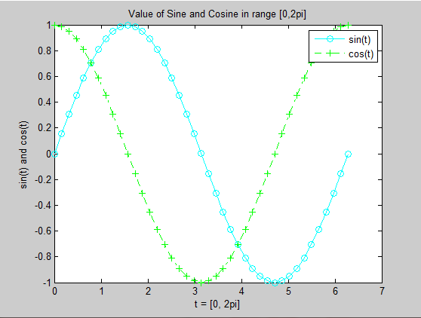
2D Plotting Basics
Title
y axis
Legend
y label
Marker
x axis
x label

Slide 10
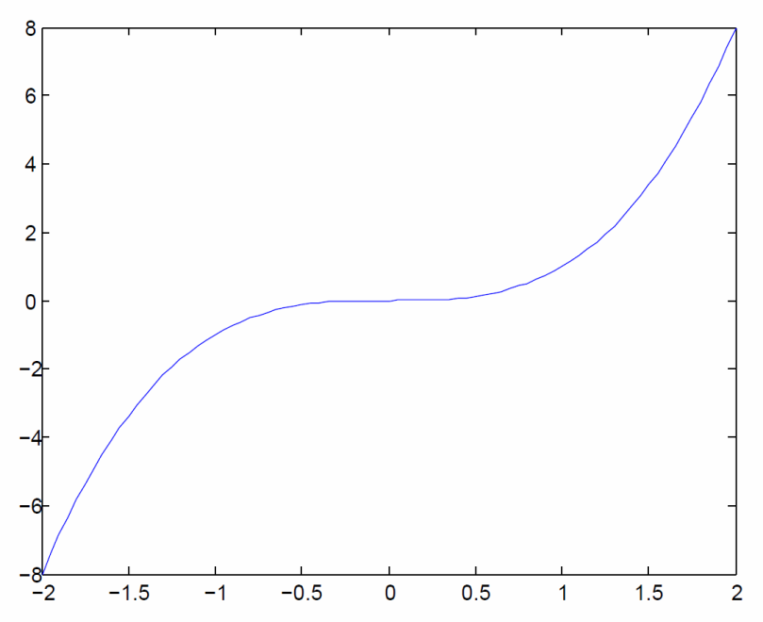
Function: plot
Screen clipping taken: 6/14/2009, 9:40 PM
plot( x, y, ‘LineSpec’, ‘PropertyName’, ‘PropertyValue’, … );
Name | Opt/Req | Description
X | Optional | Values on x-axis, default values to 1,2,3,...
y |  | Values on y-axis
'LineSpec' | Optional | Line specifiers, Default = solid line, no marker, blue color
'PropertyName' | Optional | Additional properties like LineWidth, MarkerSize, ...
'PropertyValue' | Optional | Numeric values associated with additional properties
Example:
>> x = -2:0.05:2;
>> y = power( x, 3 );
>> plot( x, y )
Let’s try it!

Slide 11
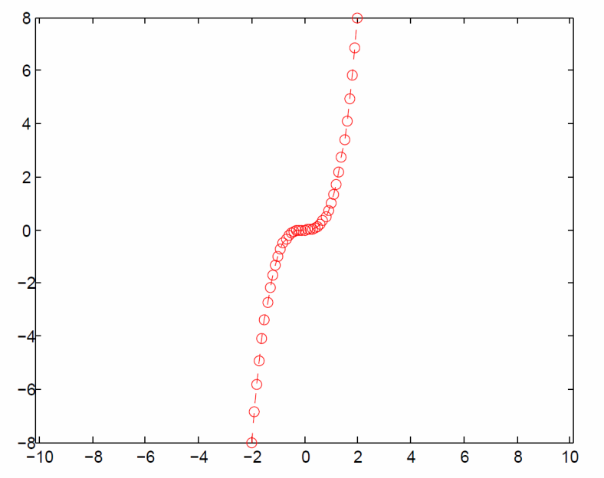
Line Specifiers
Screen clipping taken: 6/15/2009, 12:03 AM
Line Style: Solid, dashed, dotted, dash-dot
Line Color: Red, green, blue, yellow, …
Marker Style: <None>, Circle, Square, …
Example: dashed, red, circle
>> x = -2:0.05:2;
>> y = power( x, 3 );
>> plot( x, y, ‘--ro’ );
>> axis equal;

Slide 12
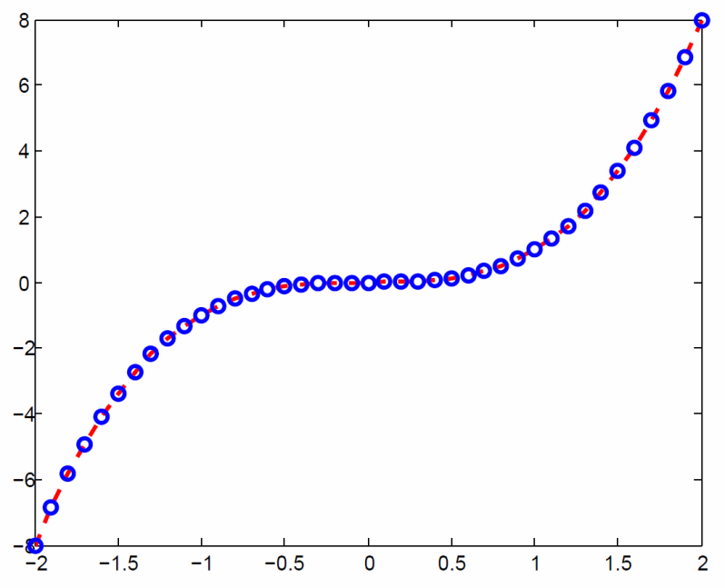
Other properties
LineWidth, MarkerSize
MarkerEdgeColor, MarkerFaceColor
Example:
thick lines,
blue markers
>> x = -2:0.2:+2;
>> y = power( x, 3 );
>> plot( x, y, '--ro', 'LineWidth', 4, …
'MarkerEdgeColor', 'b' );

Slide 13
Plot formatting Commands
Name | Description
xlabel( 't=[0:2pi]') | Sets x-axis label associated with 2D plot
ylabel( 'sin(t)' ) | Sets y-axis label associated with 2D plot
title( 't vs. sin(t)' ) | Sets the title associated with 2D plot
legend( 'sin(t)', 'cos(t)' ) | Sets the legend associated with 2D plot
text( t[3], sin(t[3]), '3rd value' ) | Sets string at specified x,y location for annotation
Name | Description
hold [on|off] | Add to or replace plots in current graph
subplot(2,2,2) | Divides current figure into m×n panes Selects subplot to render next plot into
hFig1 = figure figure( hFig3 ) | Creates an empty figure window Selects specified figure window
hCurr = gcf | returns handle to current figure
hAxis = gca | returns handle to current axes for current figure
clf clf( hFig1 ) | Clear current or specified figure window
reset( hFig1 ) | Reset all graphic object properties to defaults

Slide 14
Formatting Example
>> t = 0:pi/100:2*pi;
>> plot( t, sin(t), '--co' );
>> hold on;
>> plot(t, cos(t), '-.g+' );
>> xlabel( 't = [0, 2pi]' );
>> ylabel( 'sin(t) and cos(t)' );
>> title( 'Value of Sine and Cosine in range [0,2pi]' );
>> legend( 'sin(t)', 'cos(t)' );
>> hold off;

Slide 15
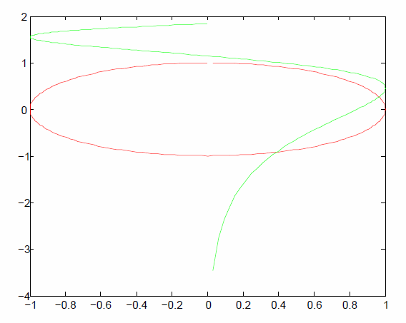
Scatter Plot
x, y can be any vector values, as long as they have the same length.
Example:
>> x = 0.01*pi:0.01*pi:2*pi;
>> plot( sin(x), cos(x), 'r' );
>> hold on
>> plot( sin(x), log(x), 'g' );
>> hold off

Slide 16
Overlaying Multiple Plots onto same figure 1st approach, vector of y-inputs
plot(x, [y1; y2; …], 'LineSpec')
All lines have the same line specifier if the ‘LineSpec’ is included
Otherwise, MATLAB chooses color automatically
Example:
>> x = 0.01*pi:0.01*pi:2*pi;
>> y = sin(x);
>> z = cos(x);
>> plot( x, [y; z] );

Slide 17
Overlaying Multiple Plots onto same figure 2nd approach, multiple inputs
plot(x, y1,'LineSpec1', …
x, y2,'LineSpec2');
All lines have the same line specifier if the ‘LineSpec’ is included
Otherwise, MATLAB chooses color automatically
Example:
>> x = 0.01*pi:0.01*pi:2*pi;
>> y = sin(x);
>> z = cos(x);
>> plot( x, y, 'r', x, z, 'g' );

Slide 18
Overlaying Multiple Plots onto same figure 3rd approach, use hold command
Use hold on, hold off commands:
plot(x, y1, ‘LineSpec’)
hold on % Save current figure for overlay
… % Overlay additional plots here…
hold off % any new plot commands will replace current figure
Example:
>> t = 0:0.01*pi:2*pi;
>> plot(t, sin(t));
>> hold on;
>> plot(t, cos(t), 'g');
>> hold off

Slide 19
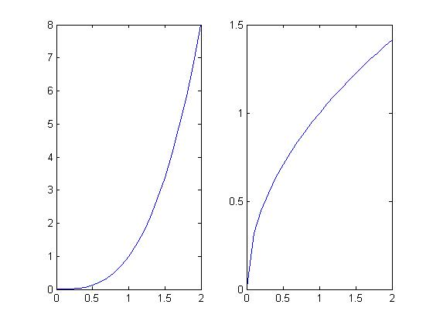
Subplot command
(3, 2, 1) | (3, 2, 2)
(3, 2, 3) | (3, 2, 4)
(3, 2, 5) | (3, 2, 6)
subplot(m, n, p)
m = # of rows
n = # of cols
p = index of sub-plot region
Splits the figure window into m×n rectangular subplot regions
The upper left subplot is indexed as 1 and the lower right subplot is indexed as m*n
>> x = 0:0.1:2;
>> y = power(x,3);
>> z = sqrt(x);
>> subplot(1,2,1);
>> plot( x, y );
>> subplot(1,2,2);
>> plot( x, z );

Slide 20
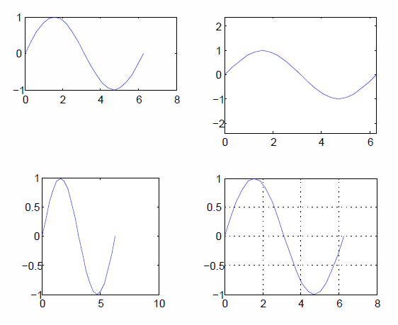
More plot commands
Name | Description
axis( [xmin, xmax, ymin, ymax] ) | Limits on display range for x and y axis
axis equal | Use same scale for both x and y axes
axis square | Set axes region to be square
grid [on|off] | add / remove grid lines from plot
min/max
equal
square
grid on

Slide 21
Edit Plot Directly
You can edit a plot directly by:
Click on Tools → Edit Plot menu item in the figure window.
Double click any item that is part of the plot you want to change
Change the properties of that item in the new window

Slide 22

Create New Blank Figure
figure create new blank figure
figure(index) create or select figure
h = gcf get current figure handle (index).
All new plot commands affect the current active figure window.

Slide 23
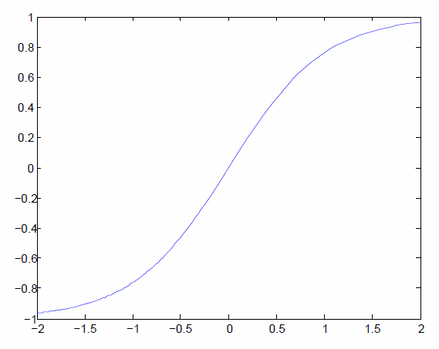
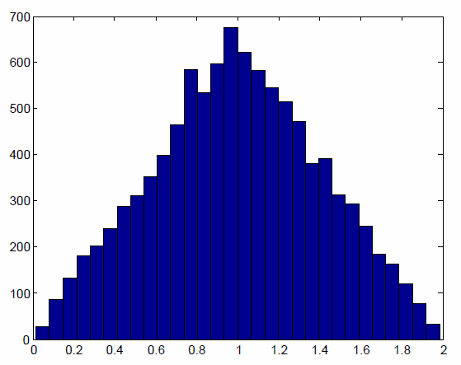
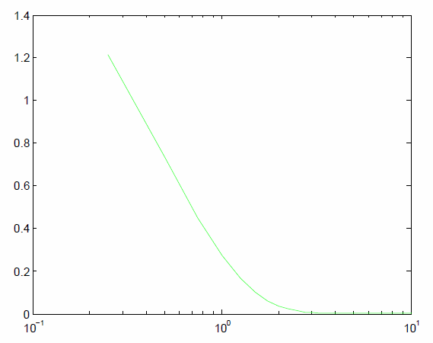
Other Plotting Commands
Name | Example | Description
hist | hist( y, nbins ); | Displays a histogram showing distribution of data
fplot | fplot('function', limits, LineSpec); | Plots function between specified limits.
semilogx | semilogx( x, y ); | Draw plot with logarithmic scale for x-axis.
semilogy | semilogy( x, y ); | Draw plot with logarithmic scale for y-axis.
loglog | loglog( x, y ); | Draw plot with logarithmic scale for both axes.
>> a = rand( 1, 10000 );
>> b = rand( 1, 10000 );
>> c = a + b;
>> hist( c, 30 );
>> x=0:.25:10;
>> y=2*exp(-2*x);
>> semilogx( x, y, ‘g’ );
>> fnch = @tanh;
>> fplot( fnch, [-2 2] );

Slide 24
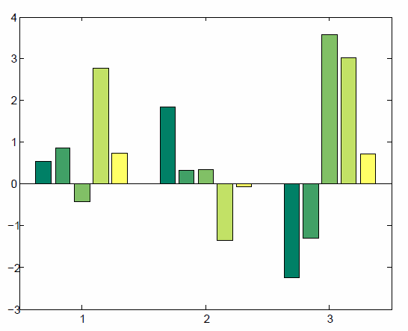
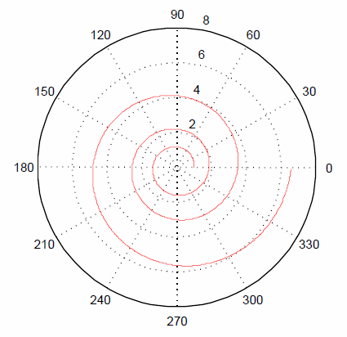
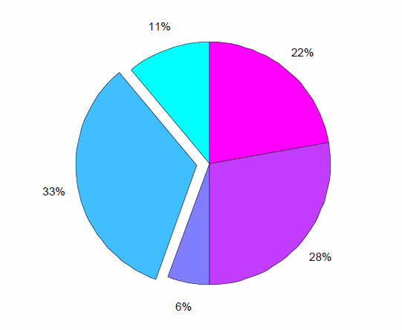
More Plotting Commands
Name | Example | Description
bar | bar( y ); | Draw a vertical bar graph.
barh | barh( y ); | Draw a horizontal bar graph.
stairs | stairs( y ); | Draws a stair step graph of the elements of Y.
stem | stem( y ); | Plots data as lines extending from baseline to stem.
pie | pie( Y ); | Draws a pie chart
polar | polar( theta, rho ); | plot x vs. y in polar coordinates.
>> x = [1 3 0.5 2.5 2];
>> explode = [0 1 0 0 0];
>> pie( x, explode );
>> colormap( cool );
>> Y = randn( 3, 5 );
>> h = bar(Y);
>> colormap summer;
>> t = 0:0.01:6*pi;
>> r = exp( .1 * t );
>> polar( t, r, '-b' )

Slide 25
Taking Quizzes/Midterms/Exams
See related slides from Monday

Slide 26
Publishing
Output your scripts as HTML, PDF or Microsoft Word Files

Slide 27
Creating a publishable script
Same as regular script except for %% command, which acts like a comment but is also used to separate commands into groups (cells) for publication purposes.
Example:
%% Publishing Reports - Simple Example
%% Area of a Circle
% Let us draw a circle in polar coordinates given by
% t = 0:0.01:2*pi;
% r(t) = t;
%% Create Vectors t and r
t = linspace( 0, 2*pi, 360 );
r = t; % make r same size as t
r(1:end) = 2; % set radius to 2
%% Now plot t vs. r using polar plot
polar( t, r, 'ro' );
Remember to save script file as pub_circle.m

Slide 28
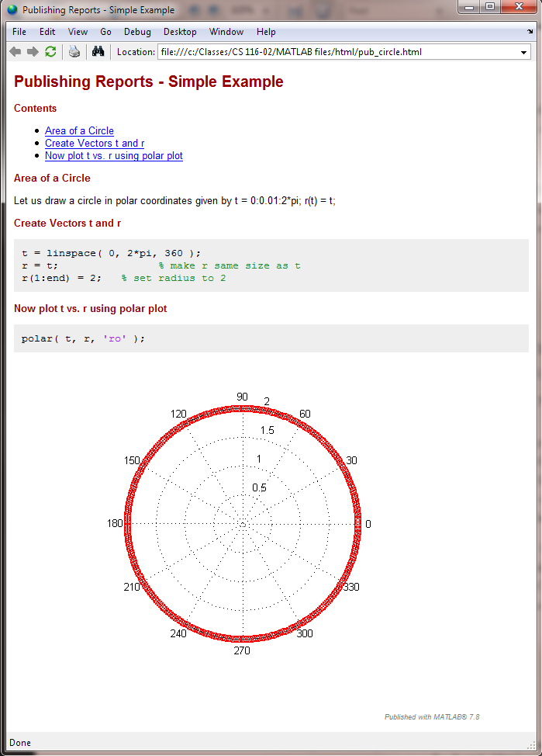
Publish Example
To publish the script
in HTML
>> publish( 'pub_circle', 'html' )
Or in MS Word
>> publish( 'pub_circle', ‘doc' )
To view published file:
>> open html/pub_circle.html
Or
>> open html/pub_circle.doc
Note: You can also publish from the script Editor window
using the File→Publish <scriptname> menu item, defaults to HMTL

Slide 29
Text Markup for Publishing
Bold Text
Use *<string>*
*Bold Text*
Italics
Use _<string>_
_Italic Text_
Monospacing
Use |<string>|
|monospace text|
Hyperlinked Text
<URL string>
<http://www.mathworks.com linktext>
Bulleted Text Items
* Item 1
* Item 2
Numbered Items
# Item 1
# Item 2
Note: You can also use the Editor window to do text markup
using the Cell→Insert Text Markup →<???> menu item

Slide 30
Reminder
Today we learned
2D Plotting (Plot command)
Line Specifiers, Other Properties
Multiple Plots
overlaying in same figure
sub-plots in same figure
Formatting commands & Other plotting commands
Publishing
Read the corresponding chapters in Attaway
Try plotting & publishing commands

Slide 31
Next Lecture
Matrices, Vectors, and Scalars

